Slide 1
Let’s talk about visual clarity
With Lucy & Freya

Slide 2
Let’s talk about visual clarity
With Lucy & Freya
(and David)

Slide 3
Resources
Weissgerber et al. (2015). Beyond bar and line graphs: time for a new data presentation paradigm. PLoS biology, doi: 10.1371/journal. Pbio.1002128
Weissgerber et al. (2019). Reveal, don’t conceal: transforming data visualization to improve transparency. Circulation, doi: 10.1161/CIRCULATIONAHA.118.037777
Midway (2020). Principles of effective data visualization. Patterns, doi: 10.1016/j.patter.2020.100141
Hehman & Xie (2021). Doing better data visualization. Advances in Methods and Practices in Psychological Science, doi: 10.1177/25152459211045334.

Slide 4
Some principles for visualising data …
Show the data
But don’t show too much
Uncertainty is important
And so is colour
Consider your audience
Get another opinion!

Slide 5
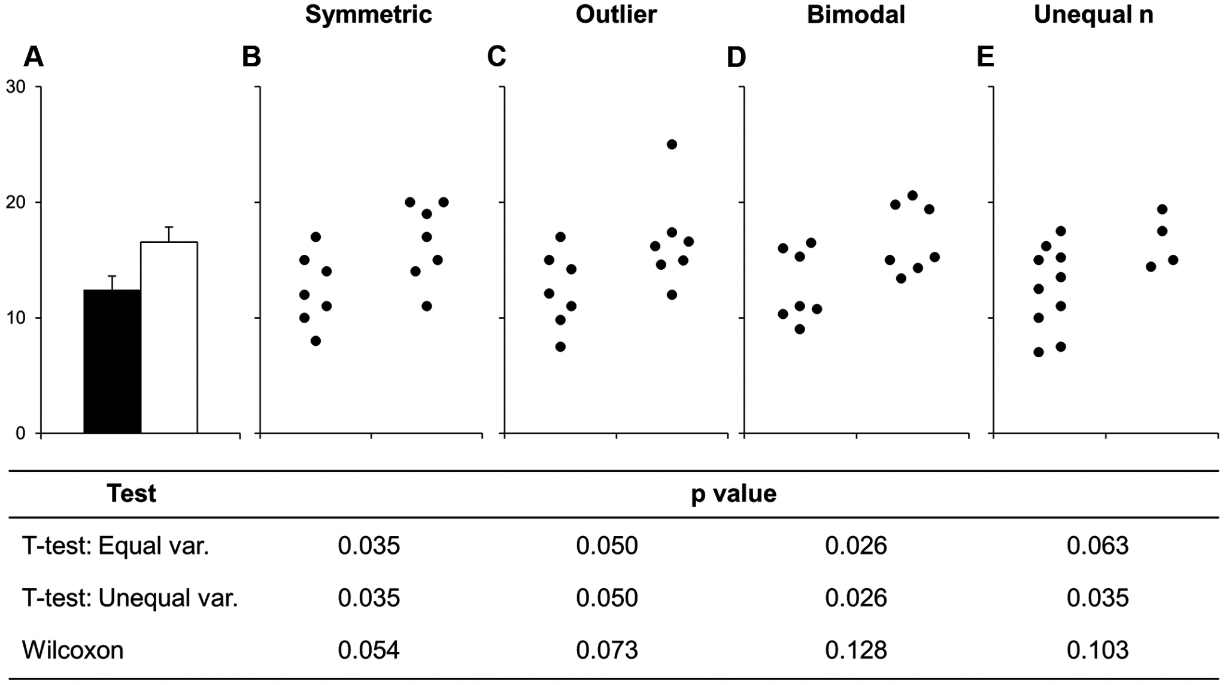
Weissgerber et al., 2015

Slide 6
Show the data
Weissgerber et al., 2015

Slide 7
Show the data
Weissgerber et al., 2015

Slide 8
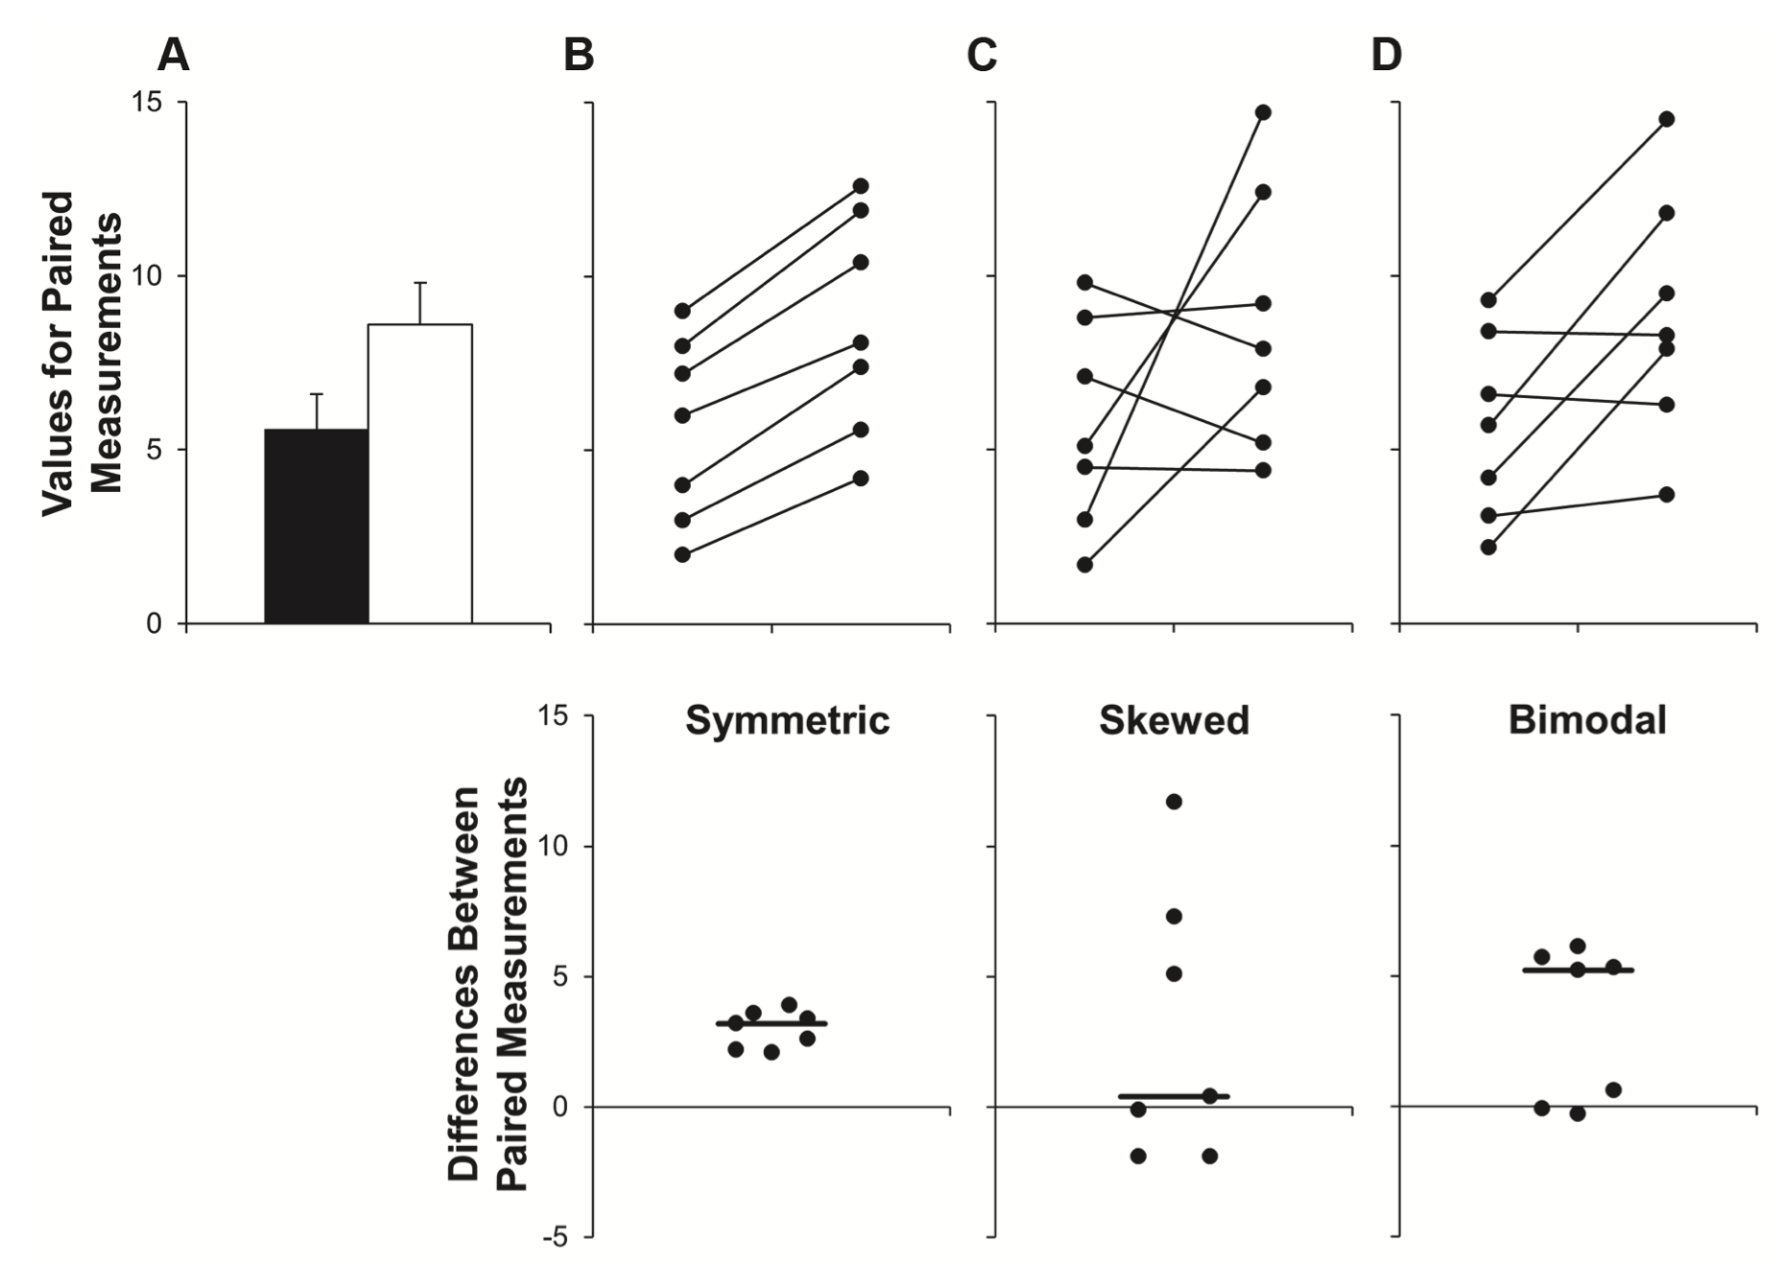
Show the data
Weissgerber et al., 2015

Slide 9
Show the data
Weissgerber et al., 2015

Slide 10
Show the data
Weissgerber et al., 2015

Slide 11
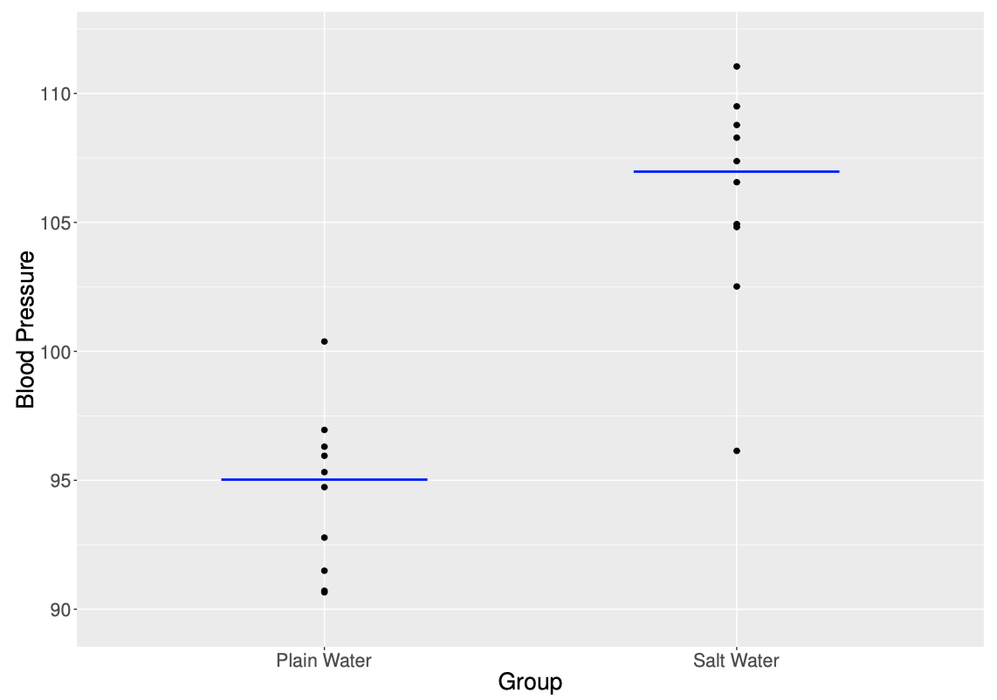

Slide 12
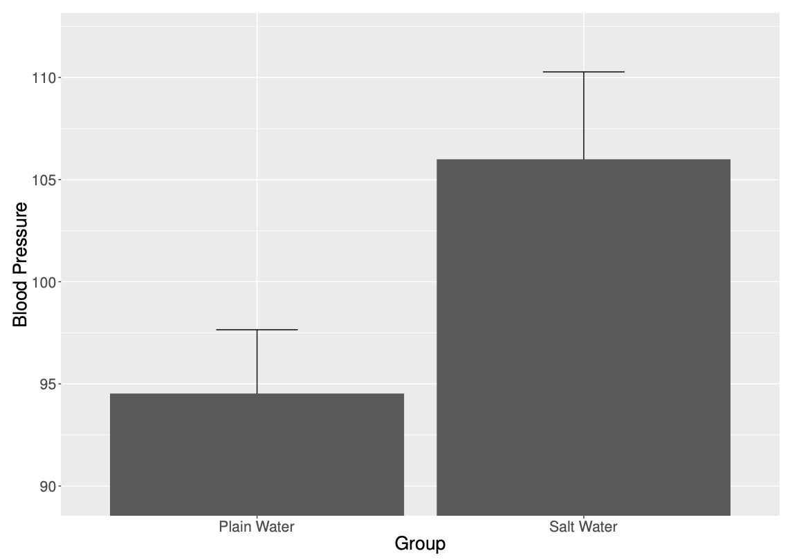

Slide 13
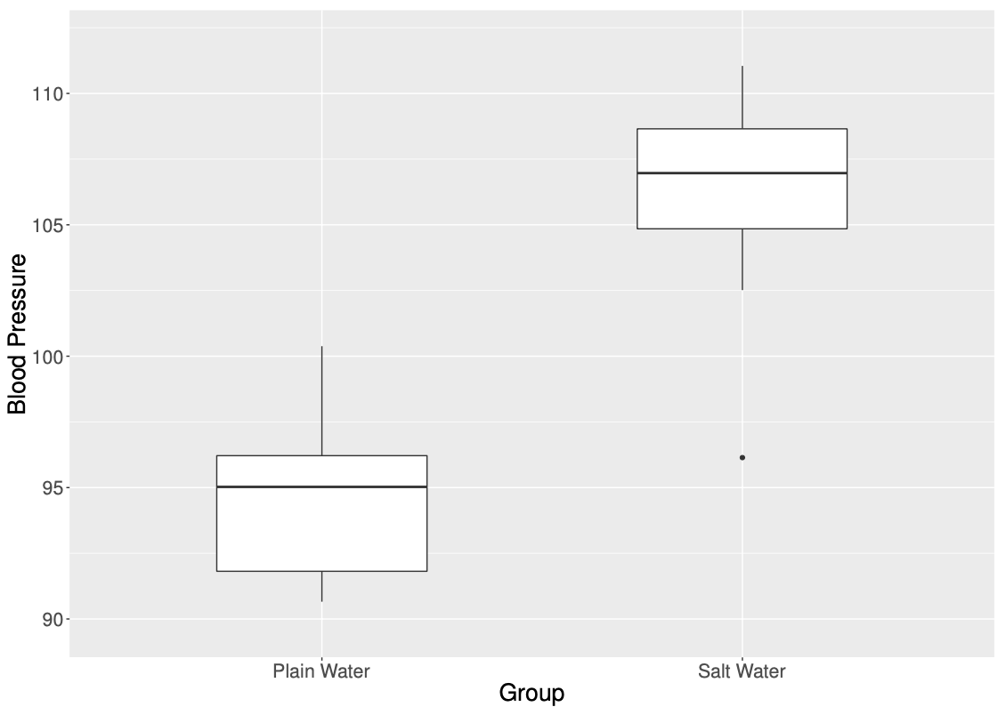

Slide 14


Slide 15
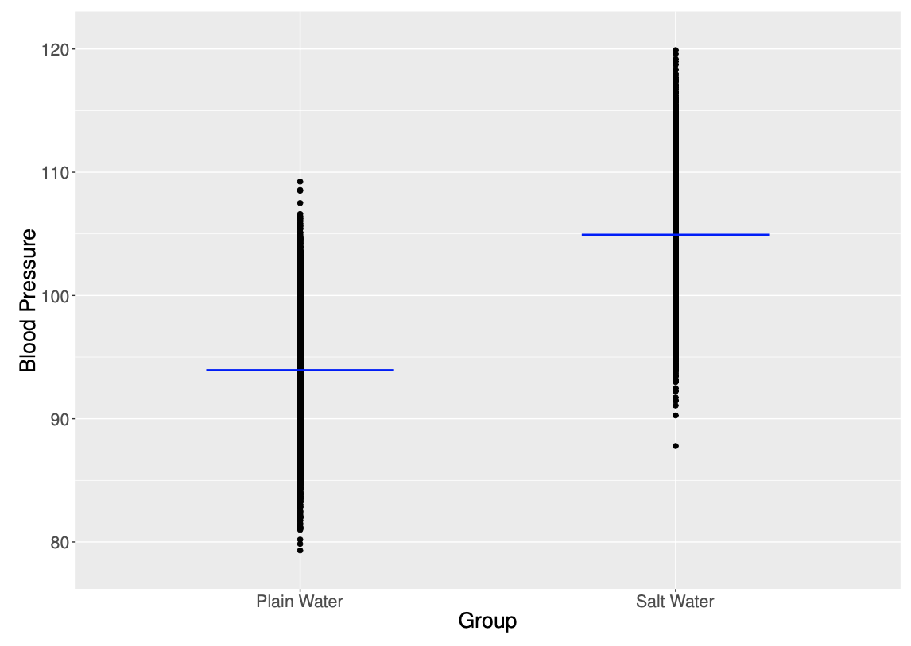

Slide 16
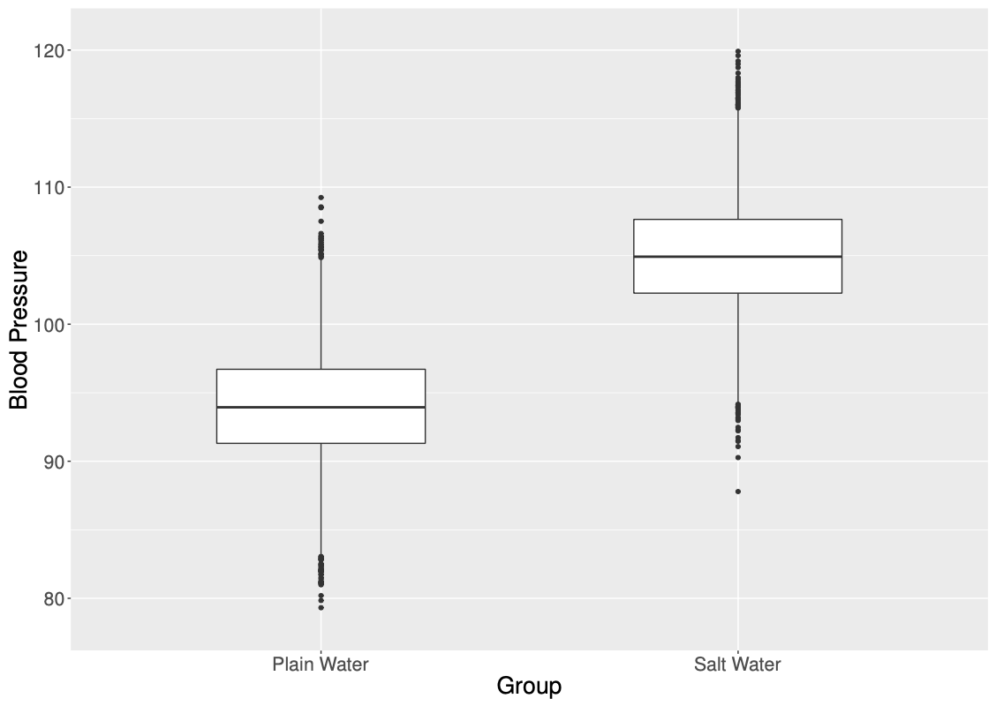

Slide 17
Do NOT show these to David !

Slide 18
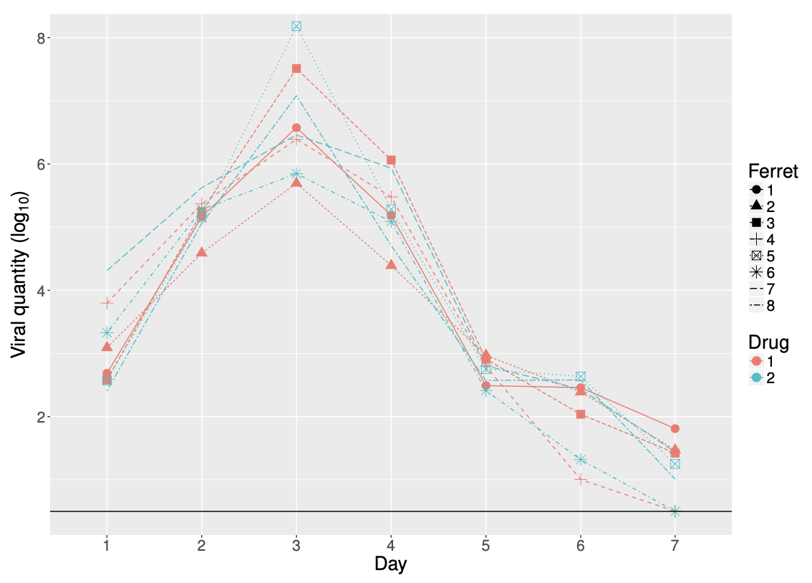
Less may be more

Slide 19
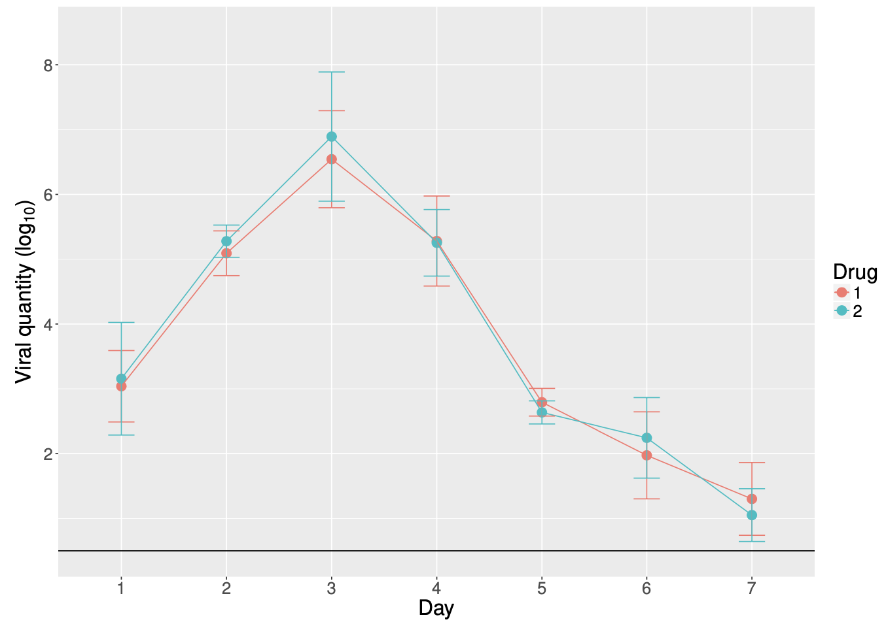
Less may be more

Slide 20
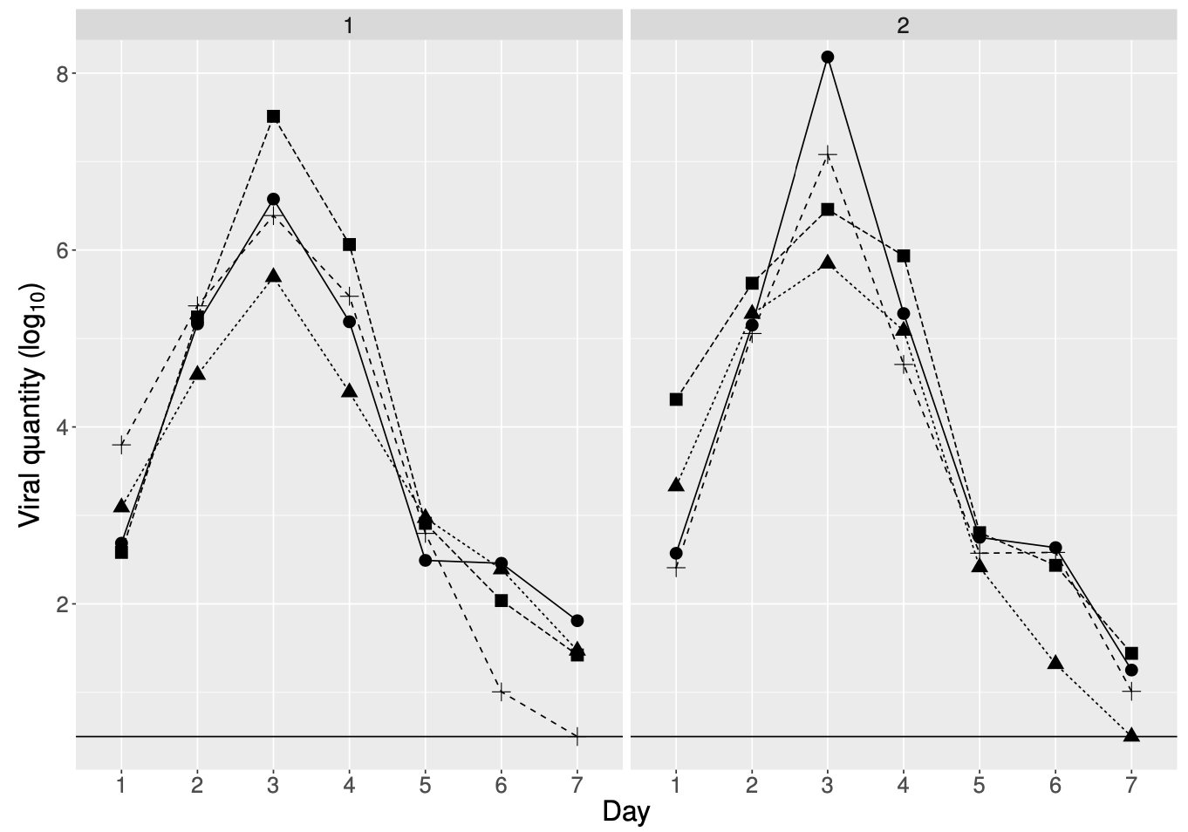
Less may be more

Slide 21
Quantiles can be misleading

Slide 22
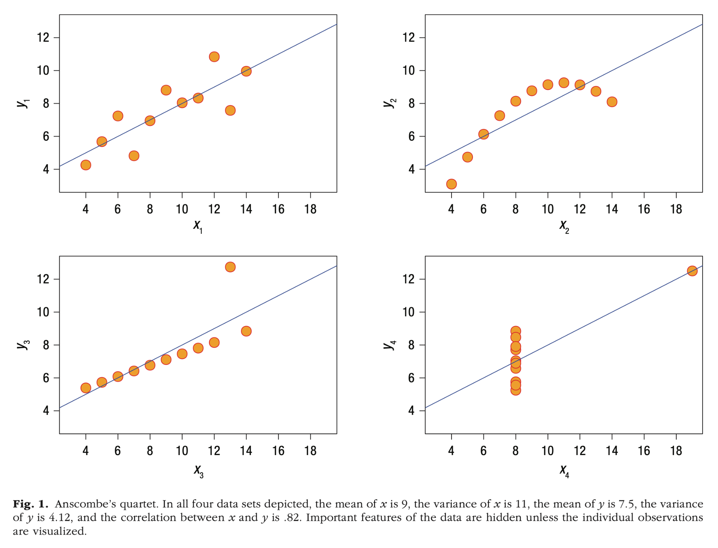
Show the data
Hehman & Xie, 2021

Slide 23
Summarising your data (e.g. “detonator plots”) can remove information

Slide 24
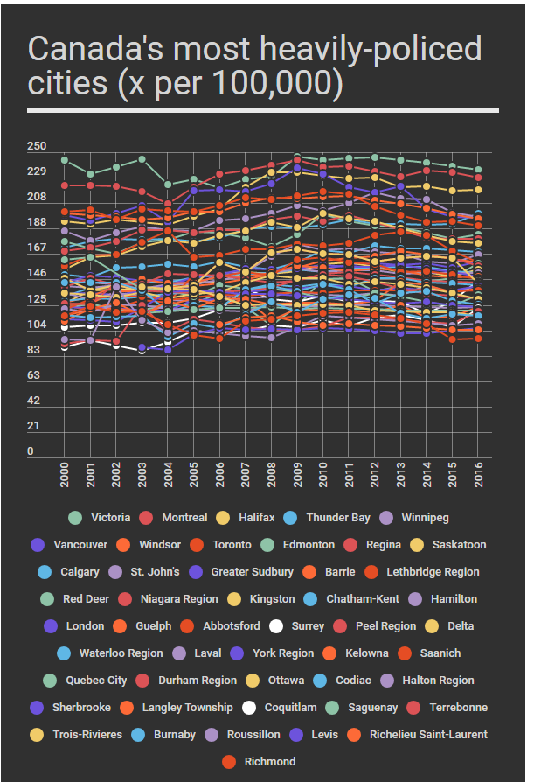
Keep it simple
(i found this on reddit)

Slide 25
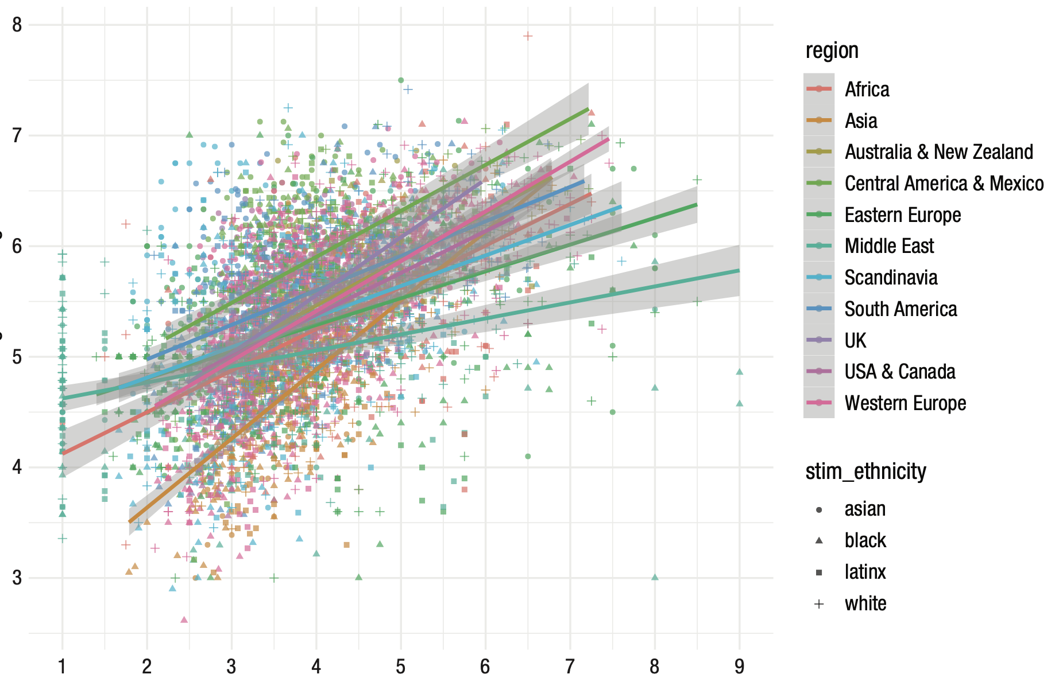
Keep it simple
Hehman & Xie, 2021

Slide 26
Colour is important!

Slide 27
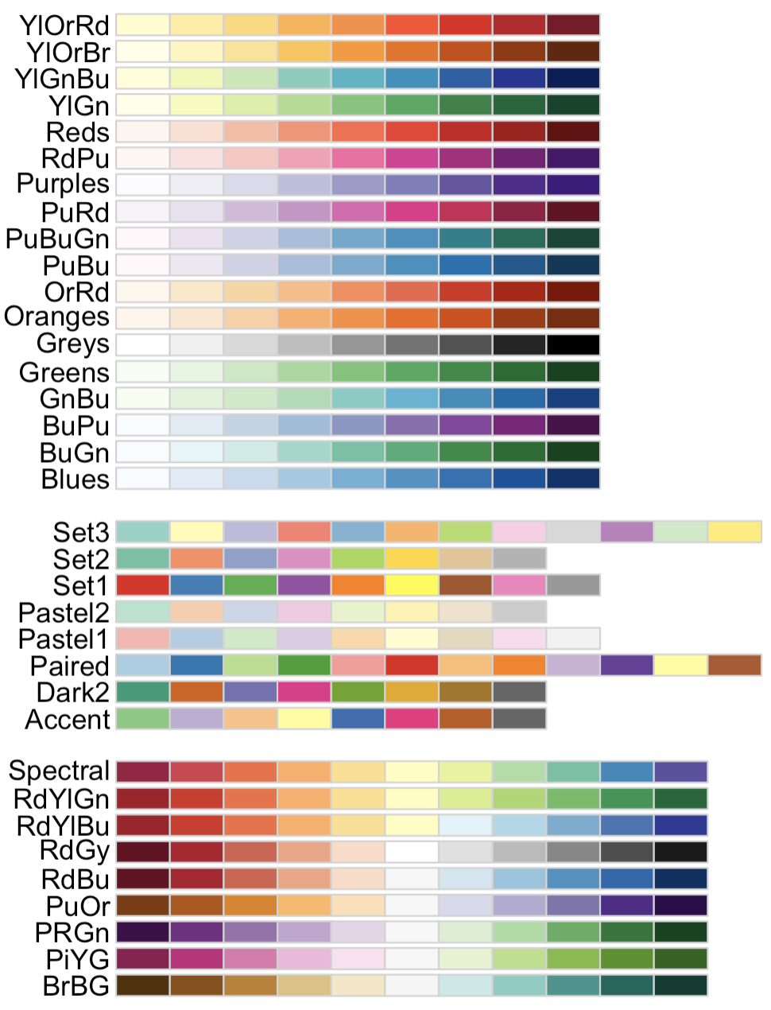
Colour is important!
Categorical / qualitative

Slide 28
Colour is important!
Categorical / qualitative
Continuous
Diverging

Slide 29
Colour is important!
Categorical / qualitative
Continuous
Diverging
Sequential
Single hue

Slide 30
Colour is important!
Categorical / qualitative
Continuous
Diverging
Sequential
Single hue
Multi-hue

Slide 31
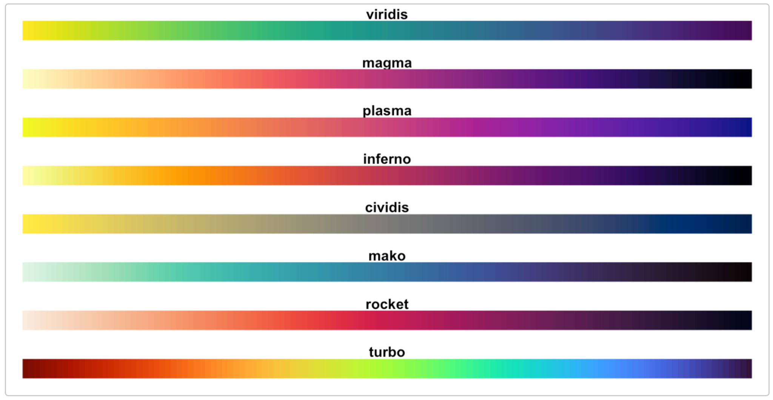
Colour is important!
Categorical / qualitative
Continuous
Diverging
Sequential
Single hue
Multi-hue
Color brewer:
https://colorbrewer2.org
Bonus: Viridis
https://cran.r-project.org/web/packages/viridis/vignettes/intro-to-viridis.html

Slide 32

Colour is important!
Categorical / qualitative
Continuous
Diverging
Sequential
Single hue
Multi-hue
Color brewer:
https://colorbrewer2.org
Bonus: Viridis
https://cran.r-project.org/web/packages/viridis/vignettes/intro-to-viridis.html

Slide 33
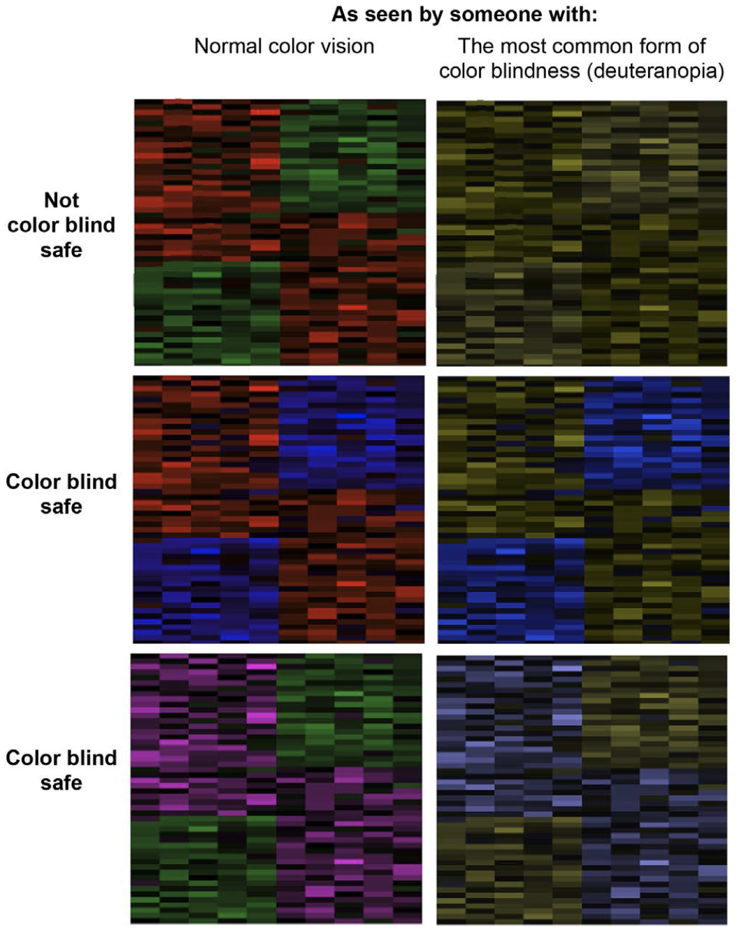
Colour is important!
Weissgerber et al., 2019 (using Color Oracle)
https://colororacle.org
Color brewer:
https://colorbrewer2.org

Slide 34
A little diversion: I love maps
Background should be distinct
Beware blue
Keep track of scale, projection + aggregation
And all of the other rules apply too

Slide 35
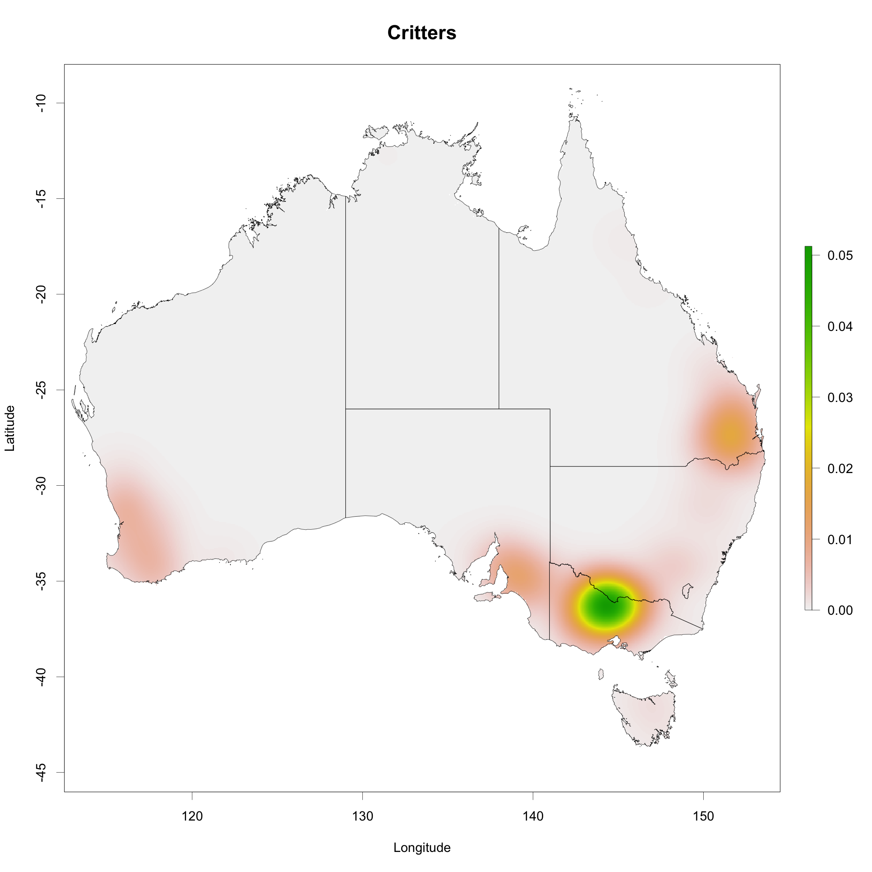
A little diversion: You love maps

Slide 36
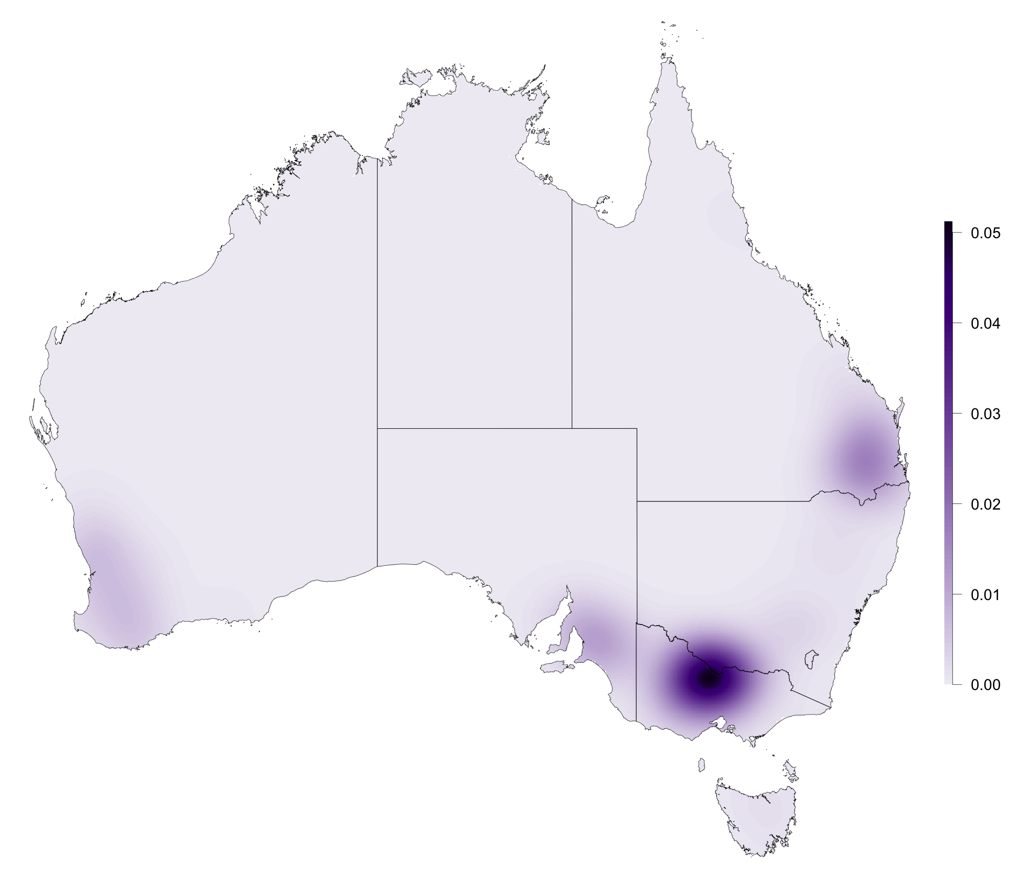
A little diversion: We love maps

Slide 37
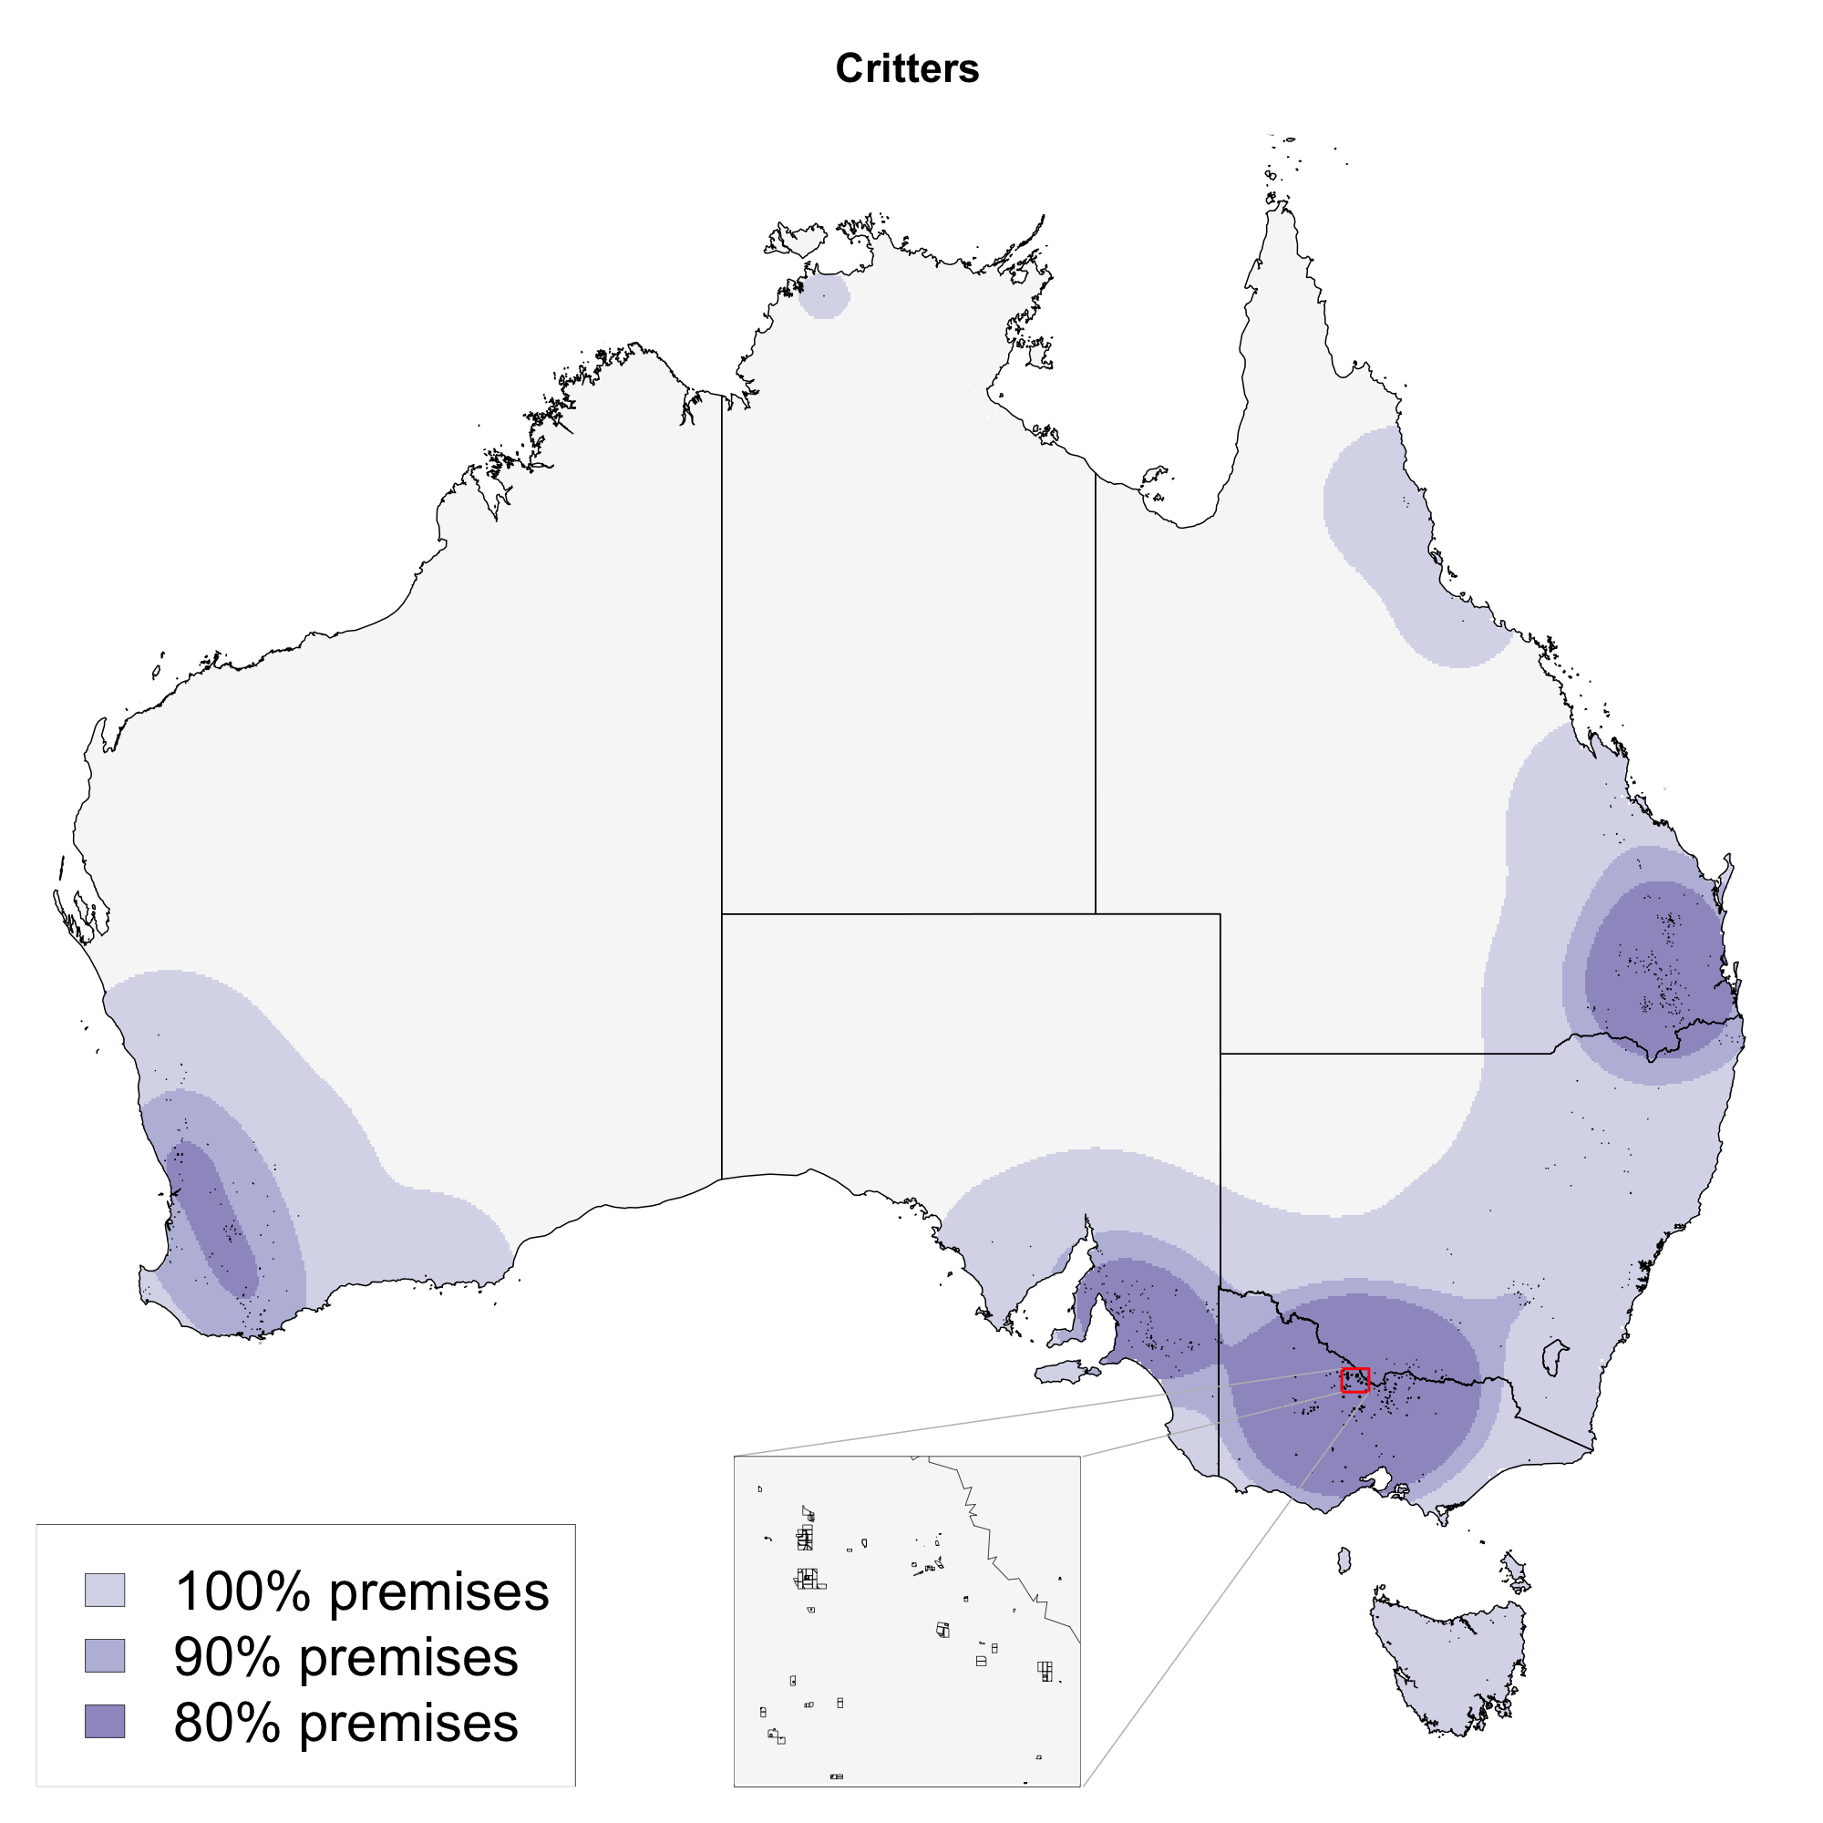
A little diversion: We love maps !!

Slide 38
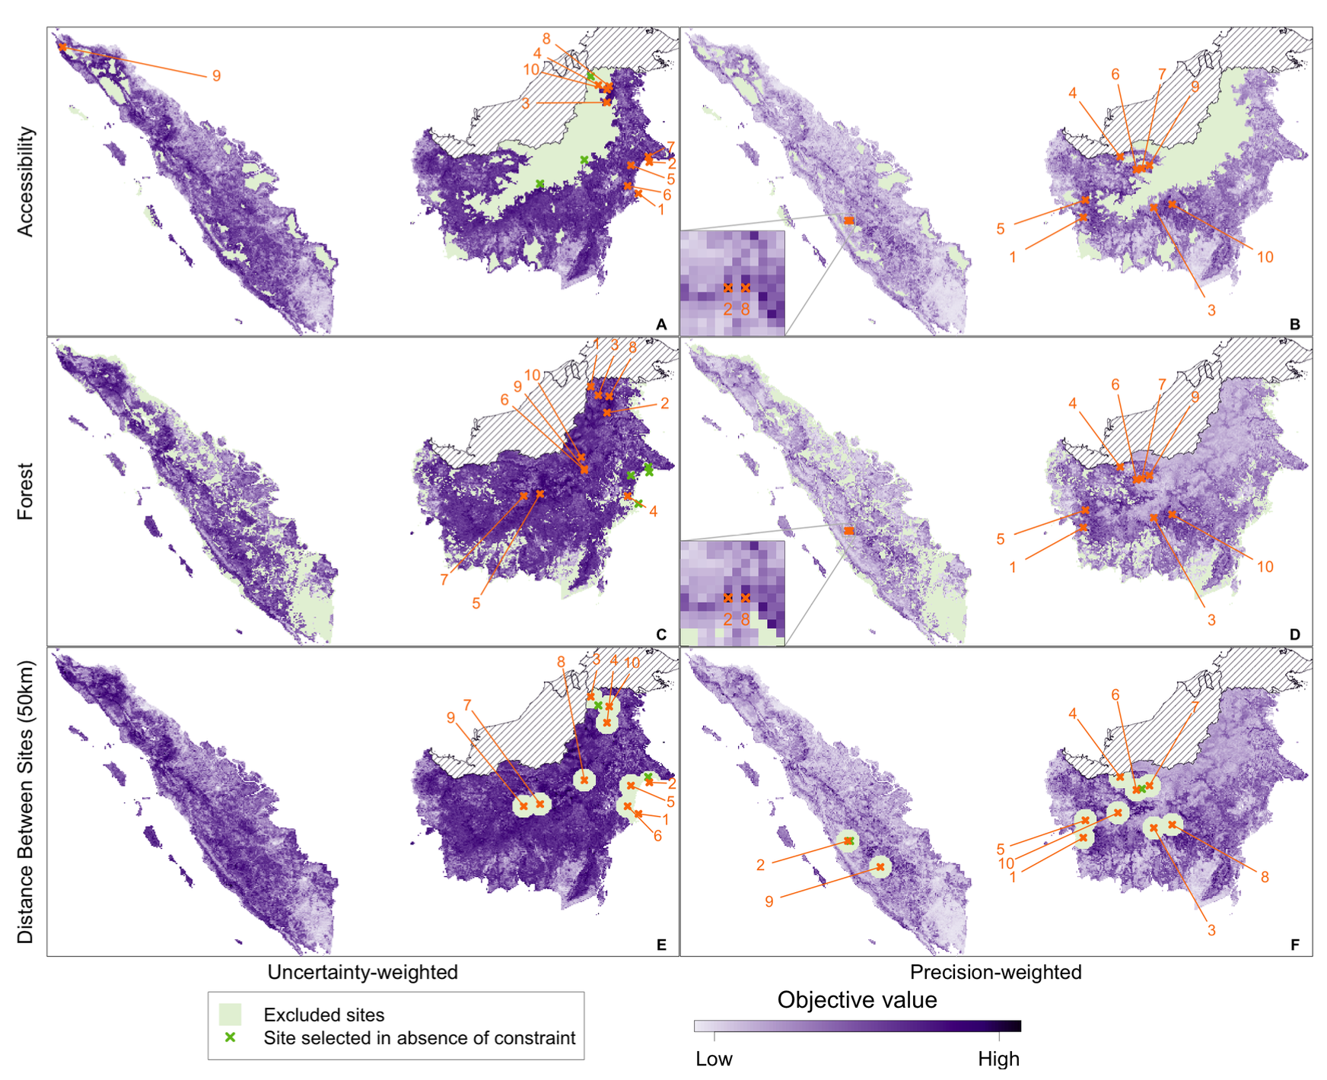
Consider your audience!

Slide 39
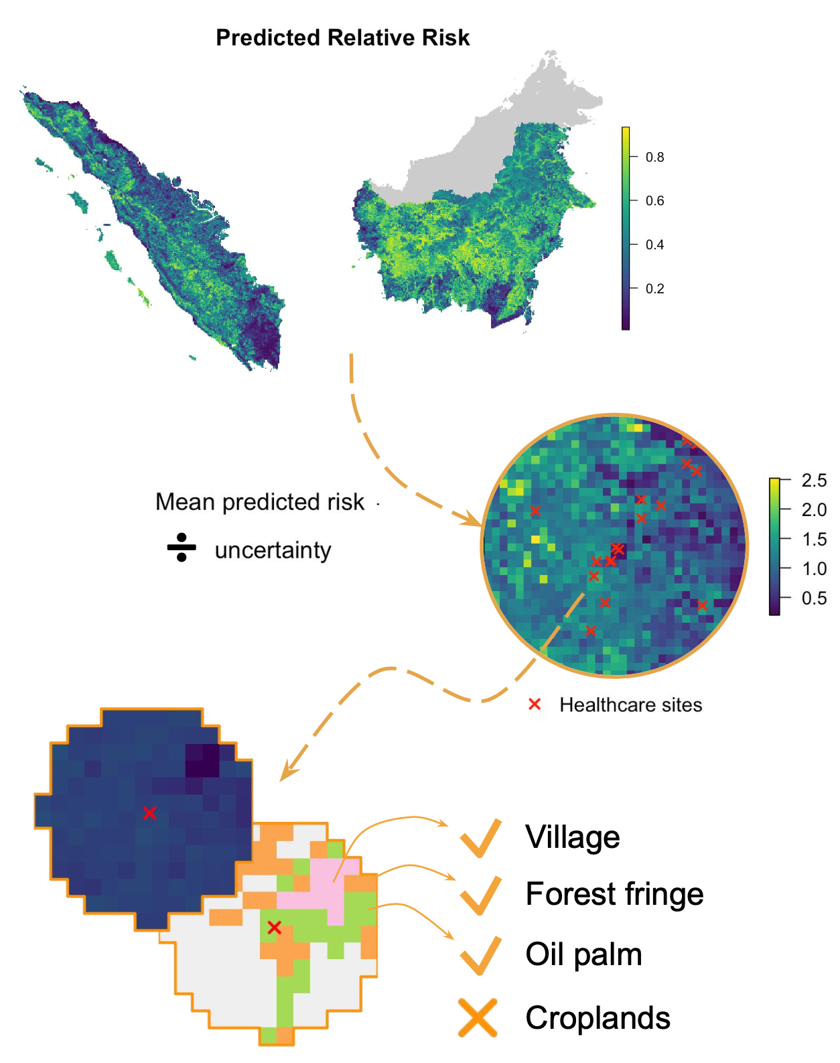
Consider your audience!

Slide 40
Finally, if in doubt …

Slide 41
Finally, if in doubt …
… get another opinion!

Slide 42
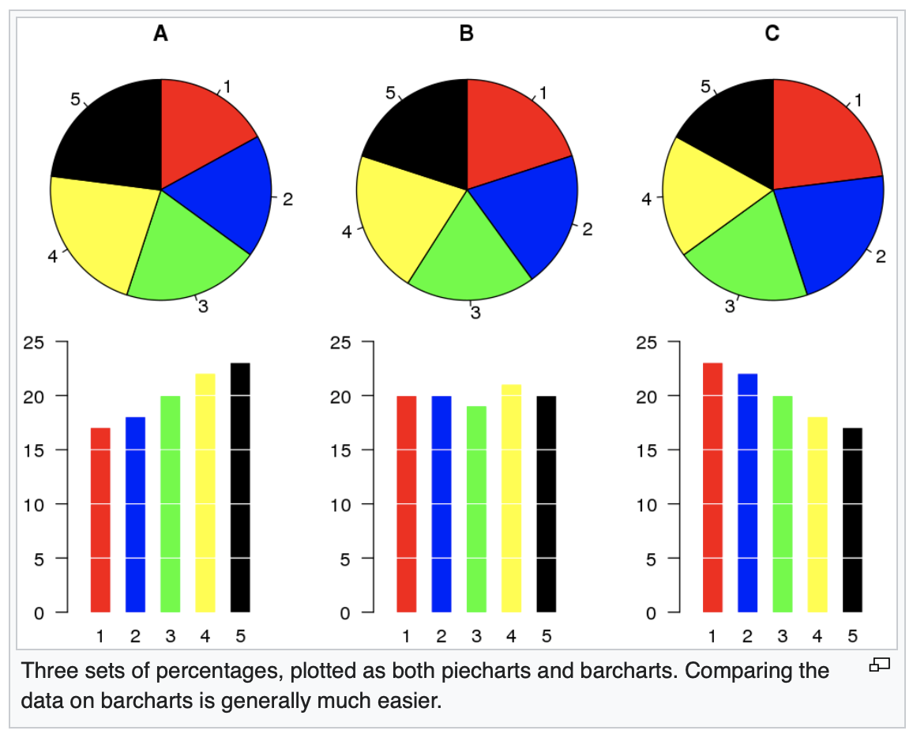
… and reconsider that pie chart!

Slide 43
In summary ..
Show the data
But keep it simple
Uncertainty is important
And so is colour
Consider your audience
Get another opinion!

Slide 44
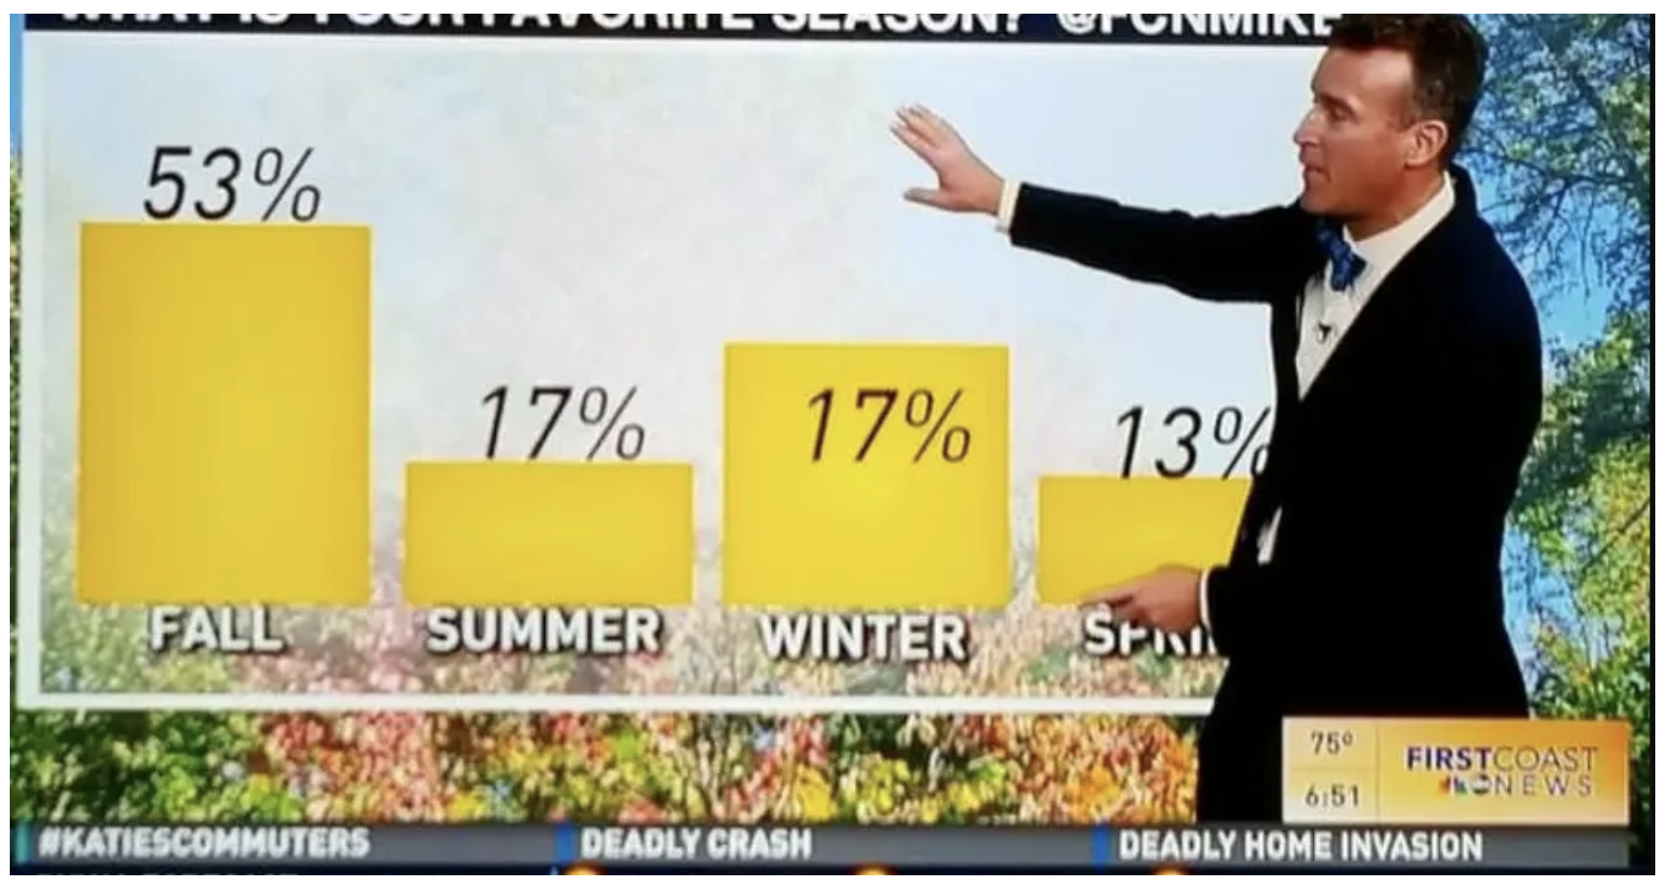
~ Let’s compare notes ~

